Slide 1
CAPSTONE PROJECT-1
Customer Segmentation
RFM Analysis
K-Means Modelling
Cohort Analysis

Slide 2
Contents
Group Members
Main Steps
Meeting Schedule
Methodology
RFM Analysis
K-Means Modelling
Cohort Analysis

Slide 3
Group Members
DA2101 - Oğuzhan
DA2102 - Birgül
DA2103 - Pakize

Slide 4
Main StepS
Data Cleaning & EDA
RFM Analysis
RFM Segmentation
K-Means Modelling
Cohort Analysis

Slide 5
Schedule
17.10 Data Cleaning & EDA
18.10 RFM Analysis & Segmentation
19.10 K-Means Modelling
20.10 Cohort Analysis
21.10 Review

Slide 6
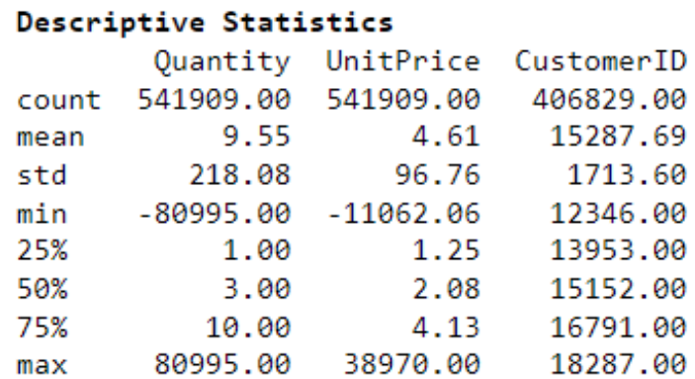
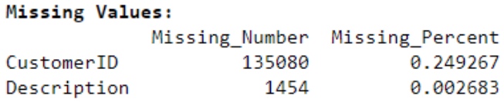
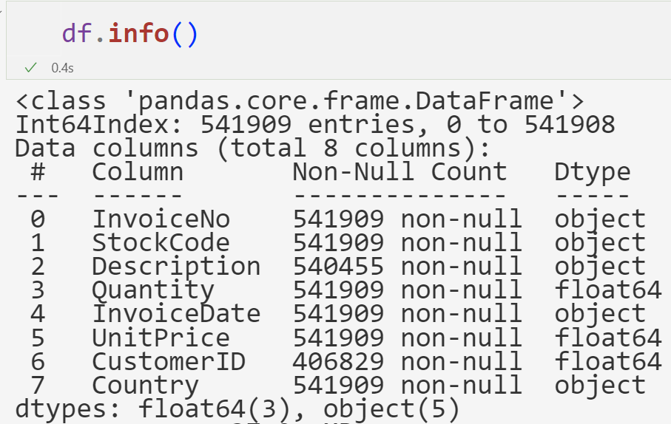
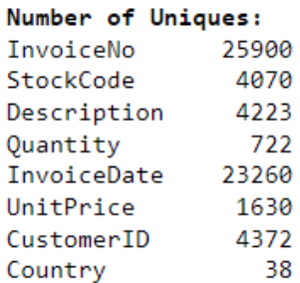
Methodology
Columns: 8 Rows: 541.909 Duplicated: 5.118

Slide 7
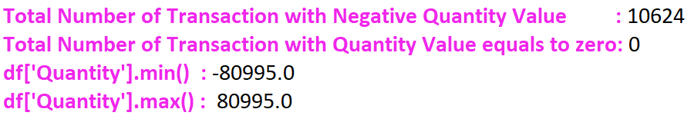
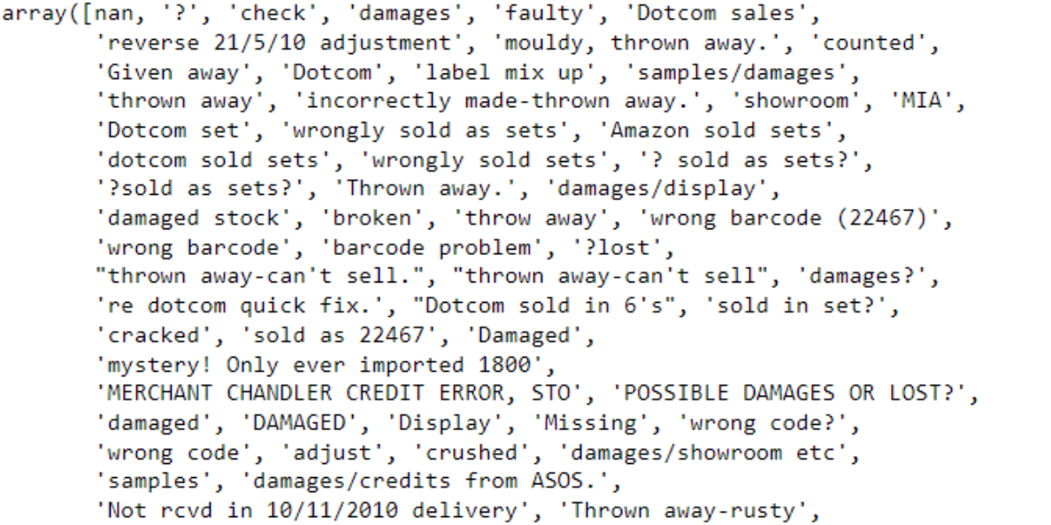
Quantity

Slide 8

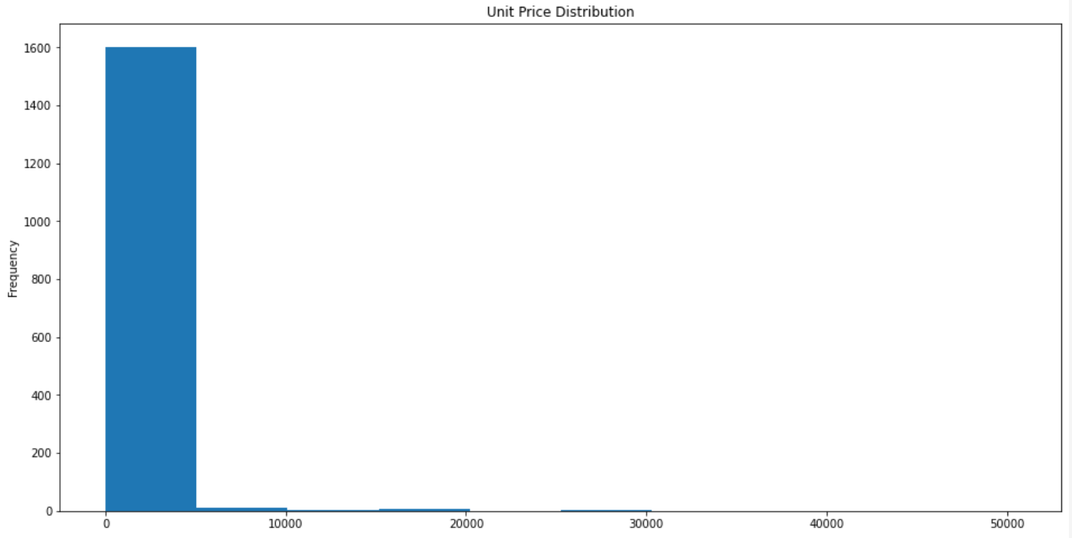
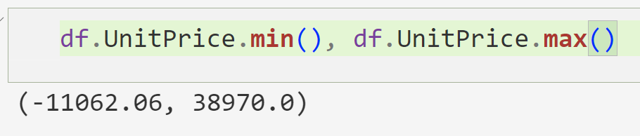
Unit Price

Slide 9
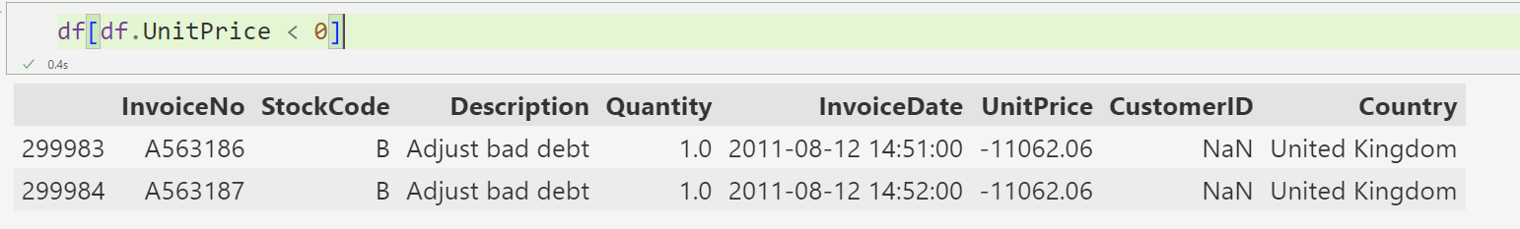
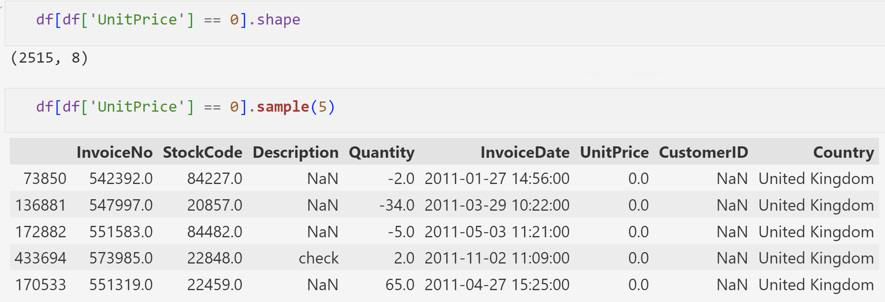

Slide 10
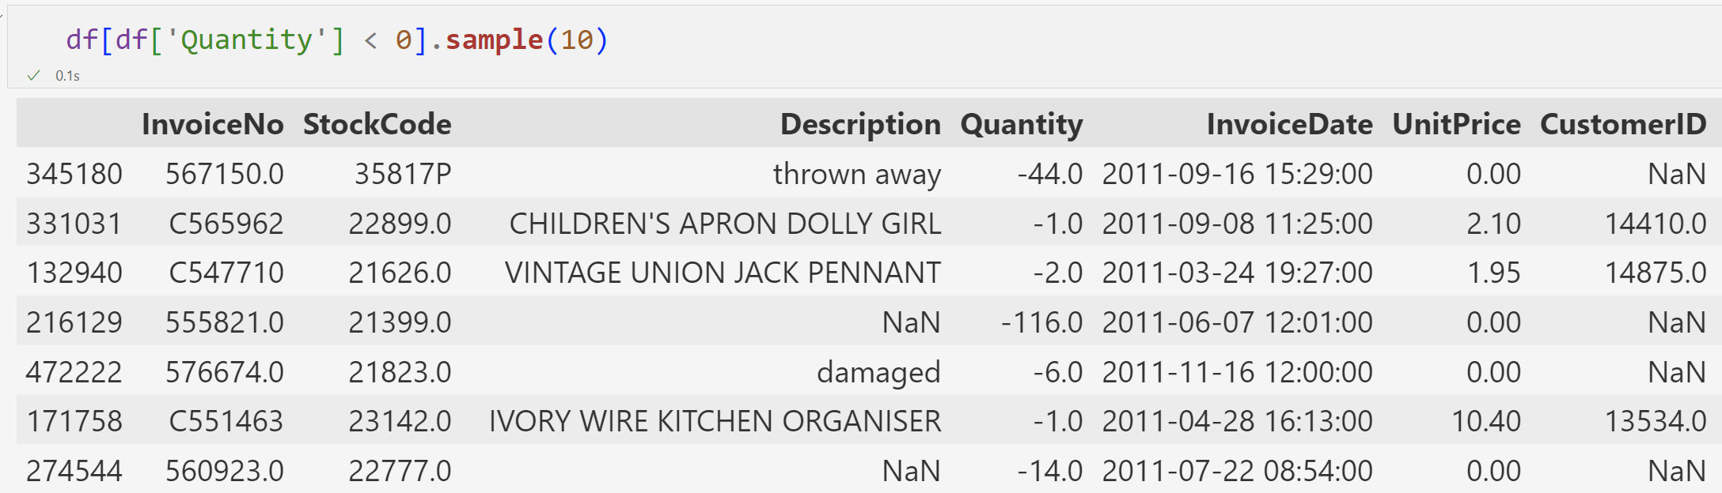
Invoice no & quantity
The number of transaction whose invoice number starts with the letter C but also has a positive quantity: 0
The number of transaction whose invoice number starts with the letter C but also has a negative quantity: 9288
The number of missing customer ID information whose invoice number does not start with c and also where the quantity is negative: 1336
The number of transactions whose invoice number does not start with c and also whose quantity is negative: 1336
There is no customer identification information for transactions whose invoice number does not start with c and whose amount is negative.

Slide 11
Methodology
Total Number of Transactions : 541909
Number of Cancelled Transactions : 9288
Percentage of Cancelled Transactions : %1.71
Unique invoices : 25.900

Slide 12
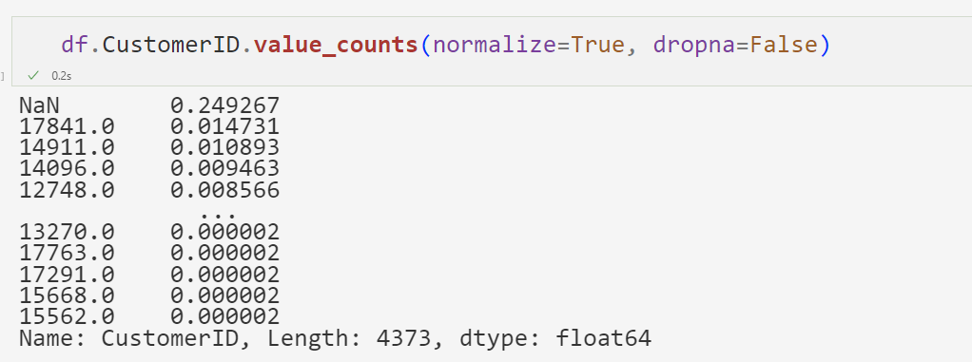
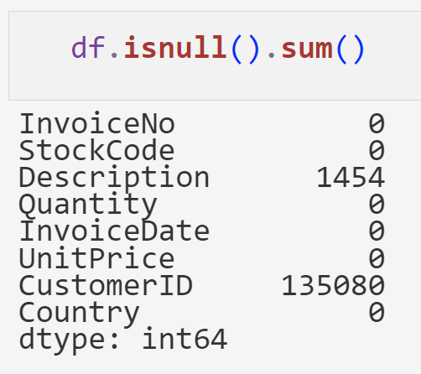
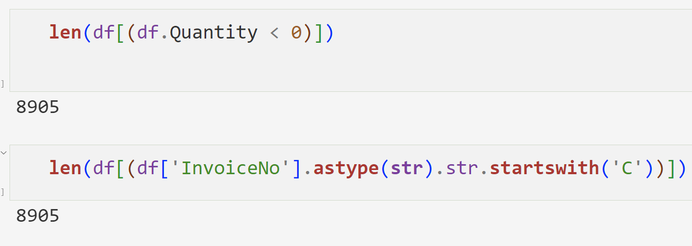
Missing values & cancelled orders
The invoice number information of this remaining negative-valued quantity line starts with C, that means, these transactions have been cancelled.

Slide 13
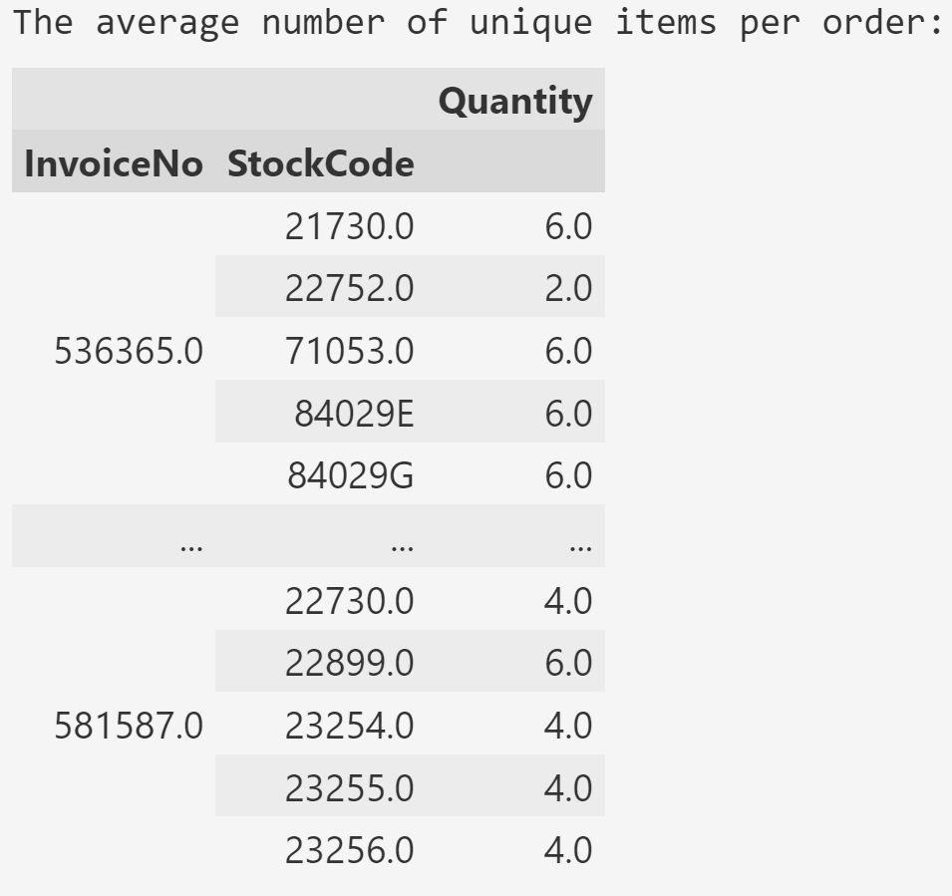
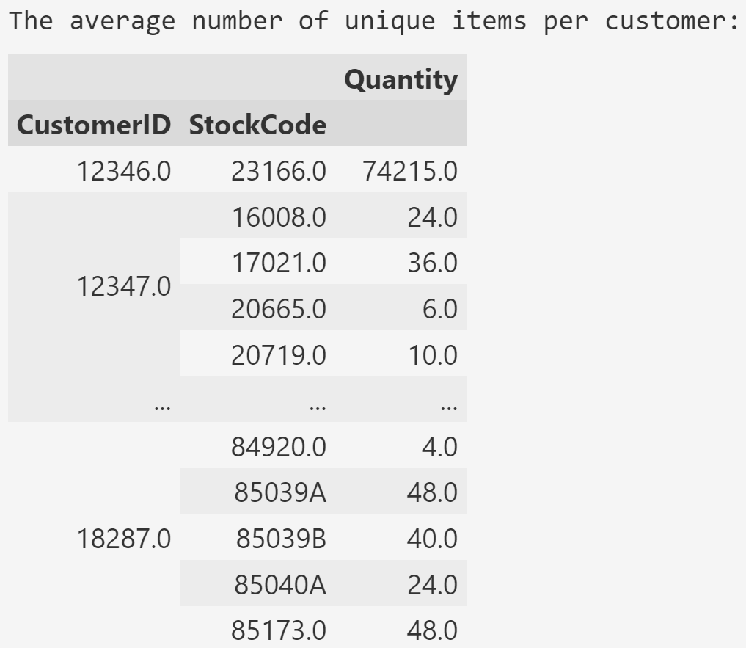
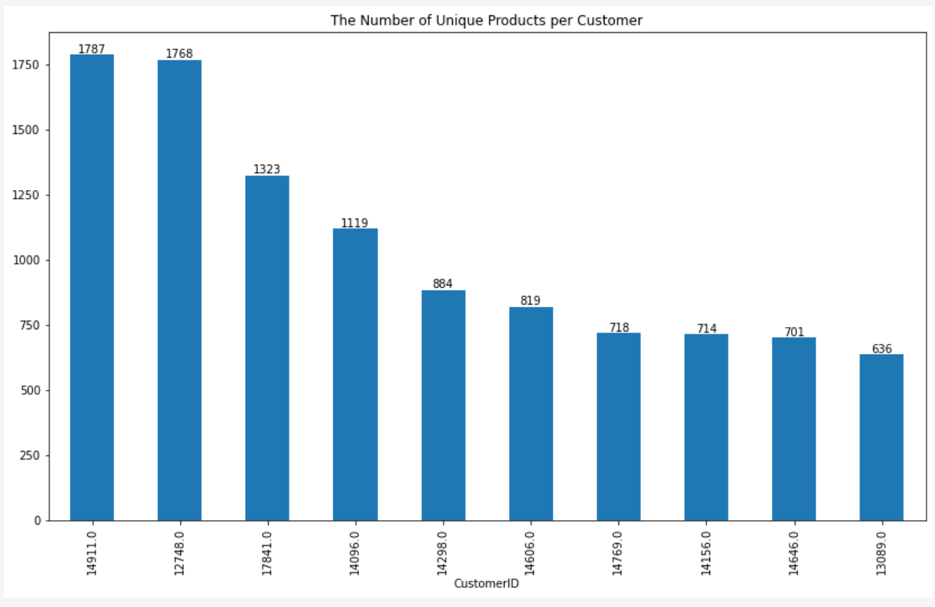
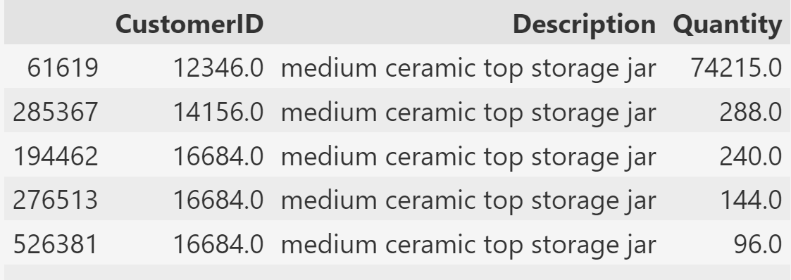
the average number of unique items per order or per customer
What is this product and how much did other customers buy?

Slide 14
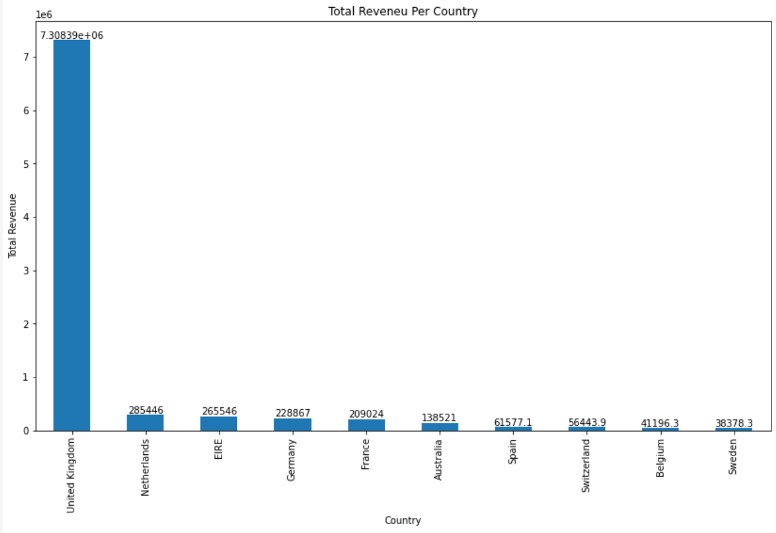
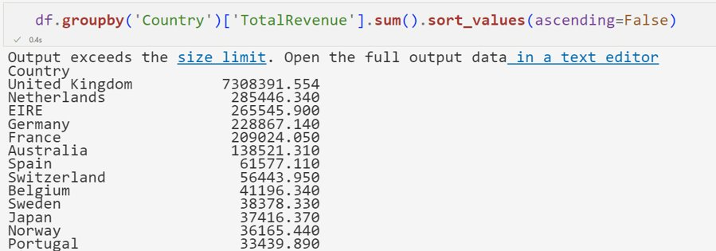
the total revenue per country

Slide 15
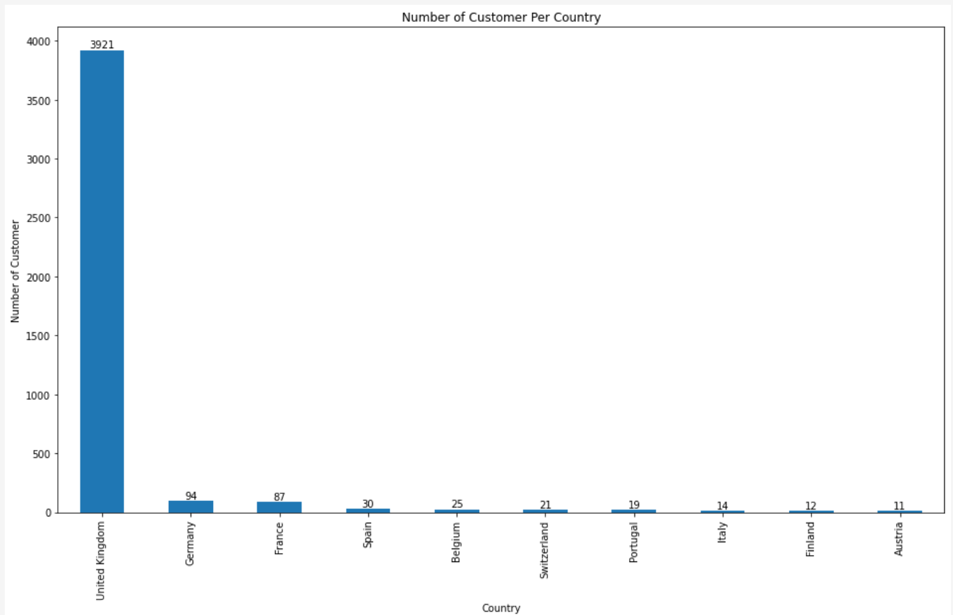
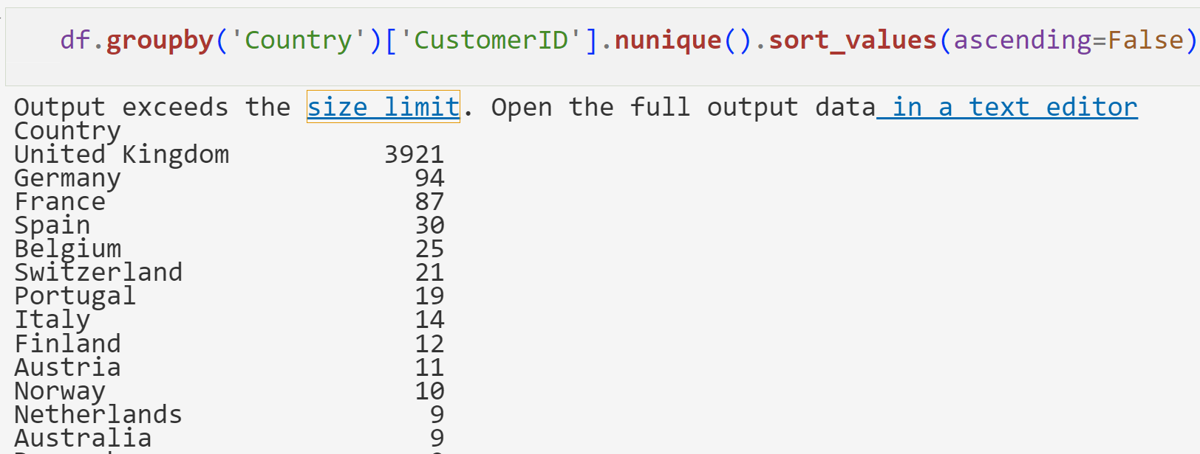
The number of customer per country
The UK not only has the most sales revenue, but also the most customers.

Slide 16
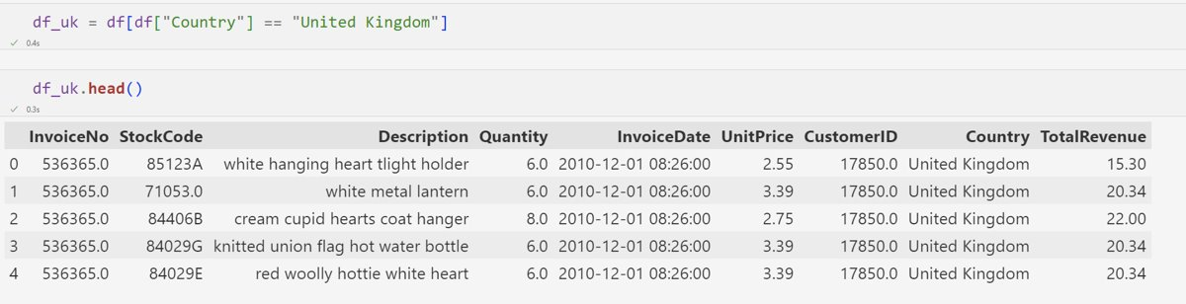
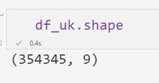
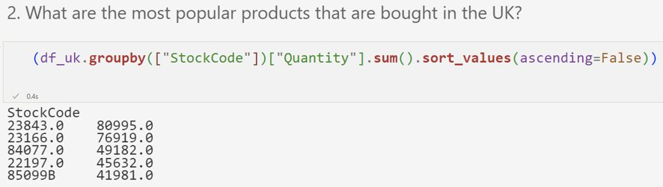
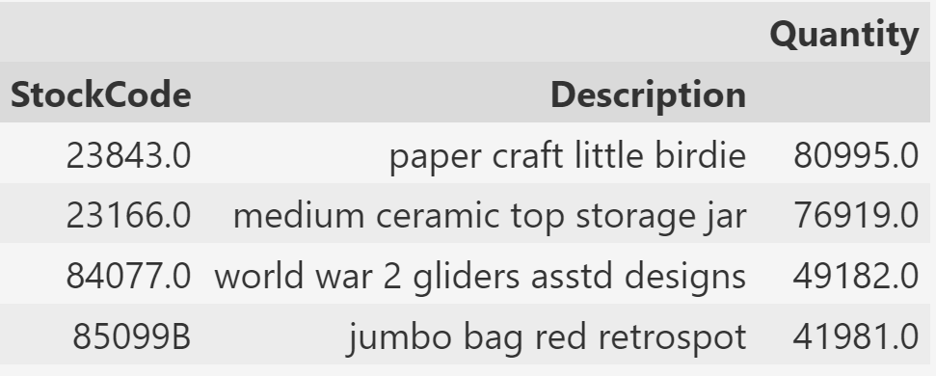
Explore the UK Market

Slide 17
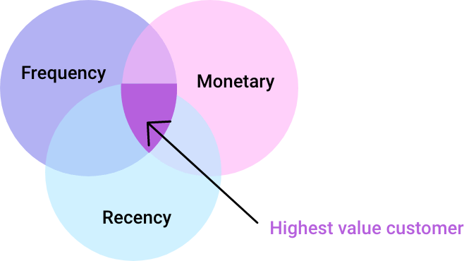
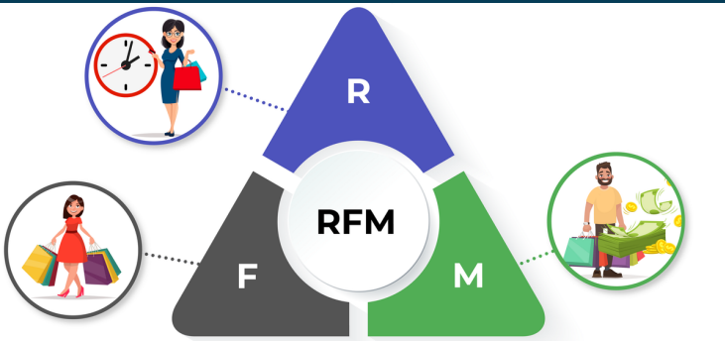
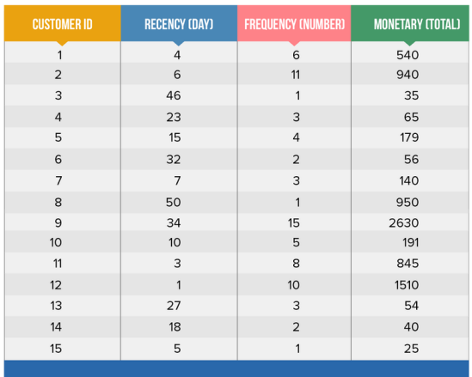
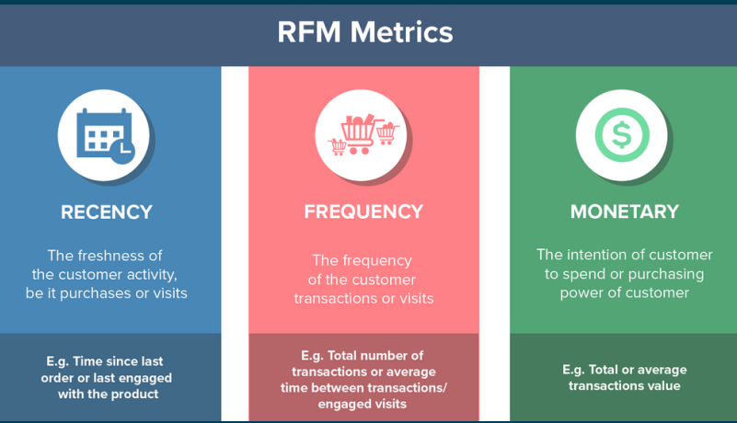

Slide 18
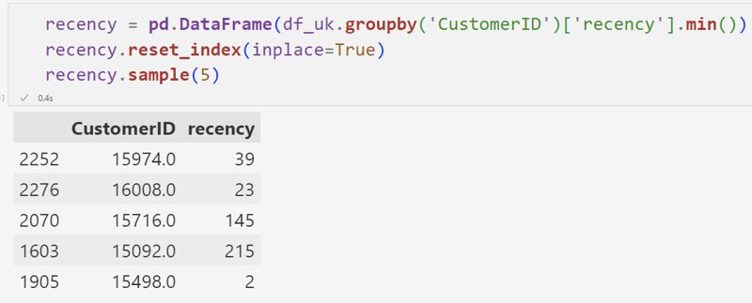
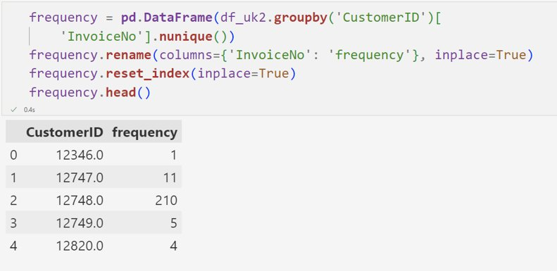
rfm

Slide 19
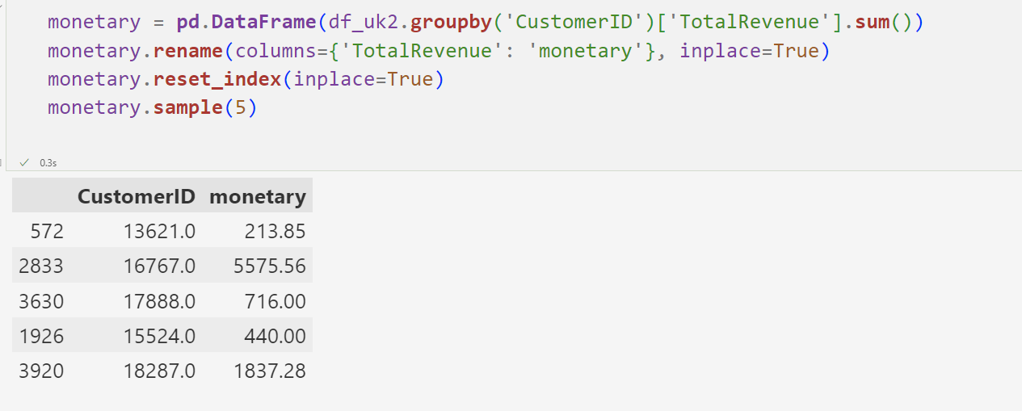
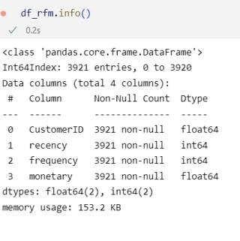
rfM

Slide 20
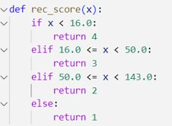
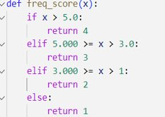
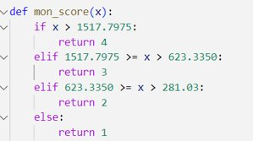
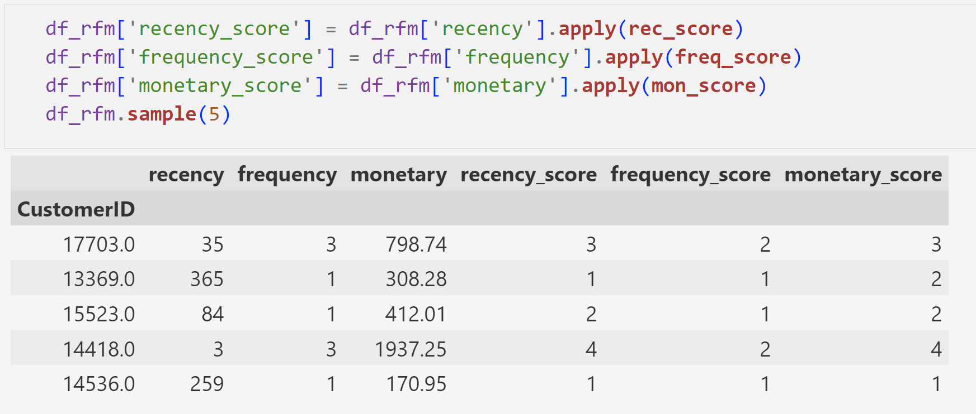
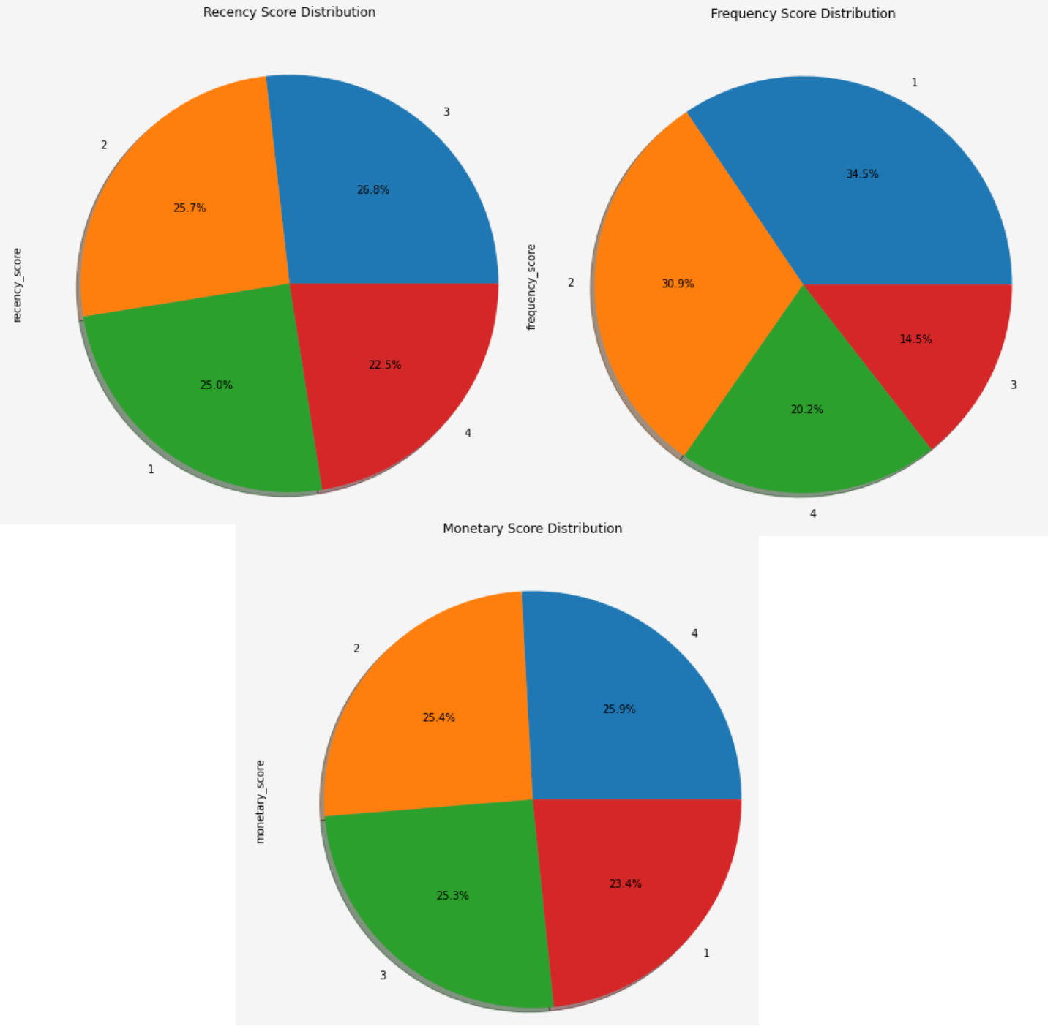
Rfm SCORE

Slide 21
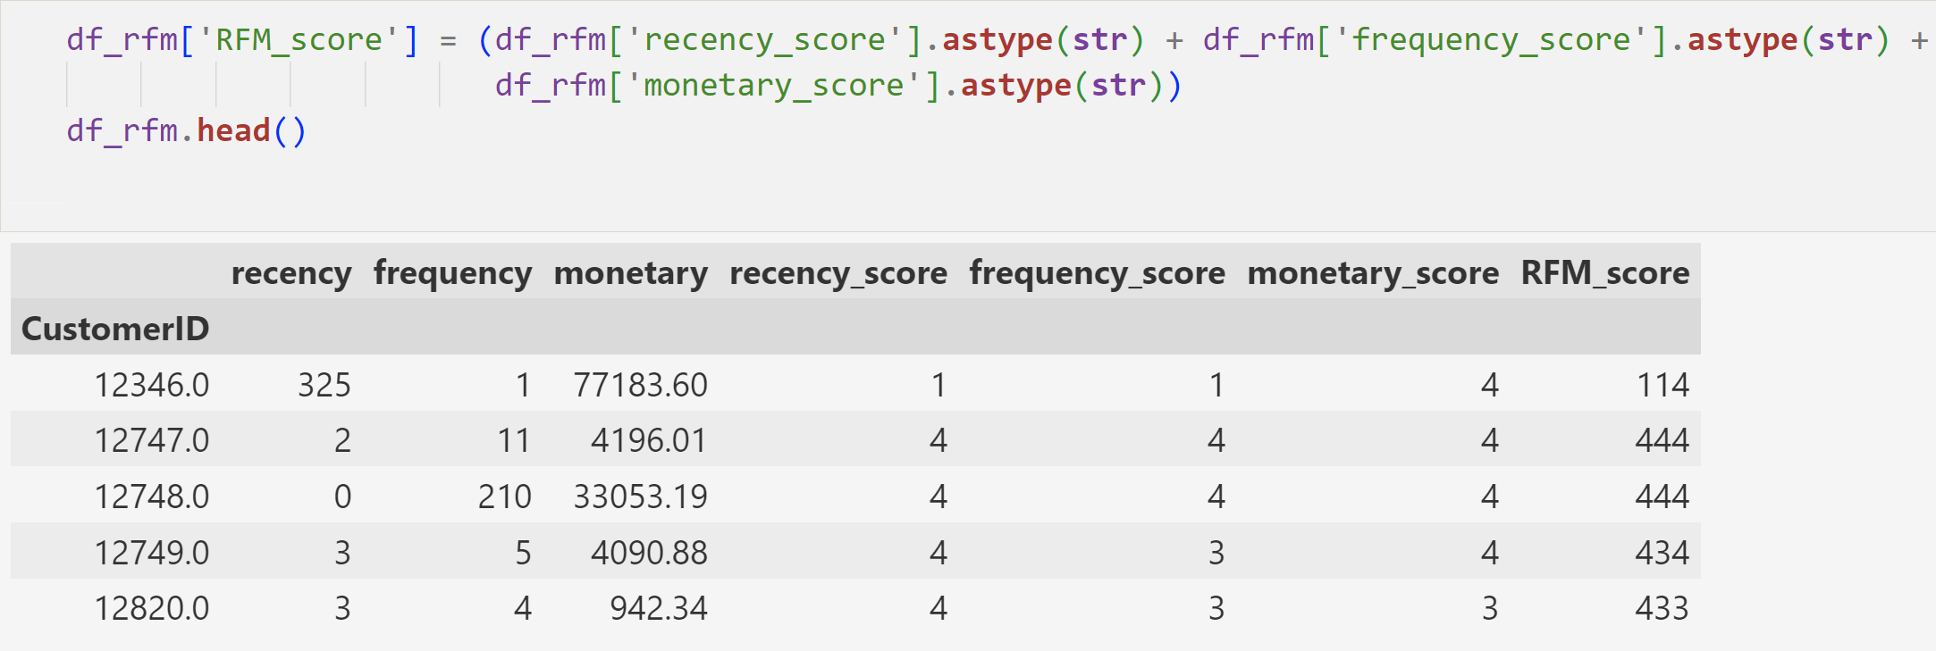
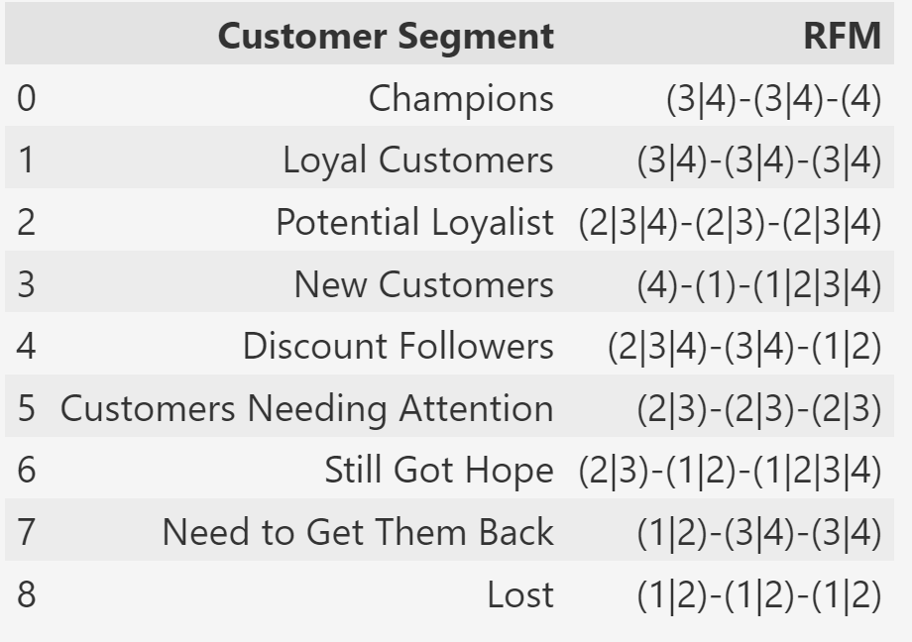
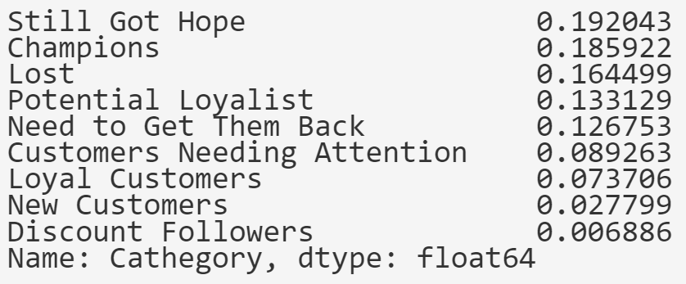
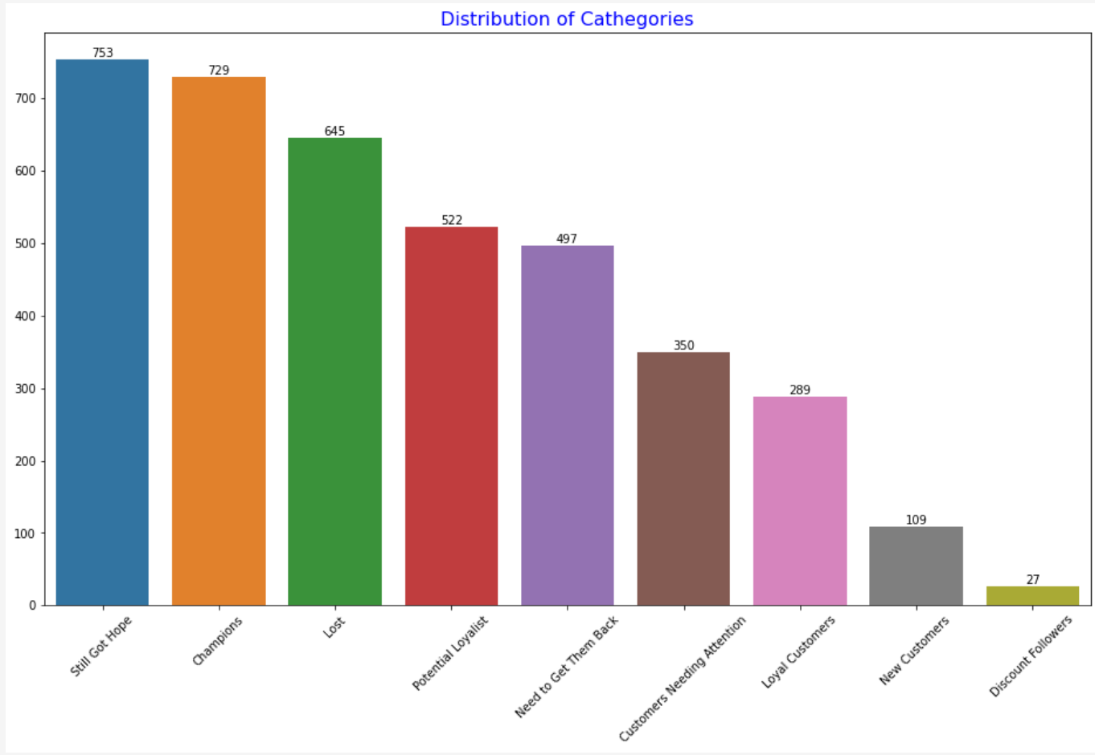
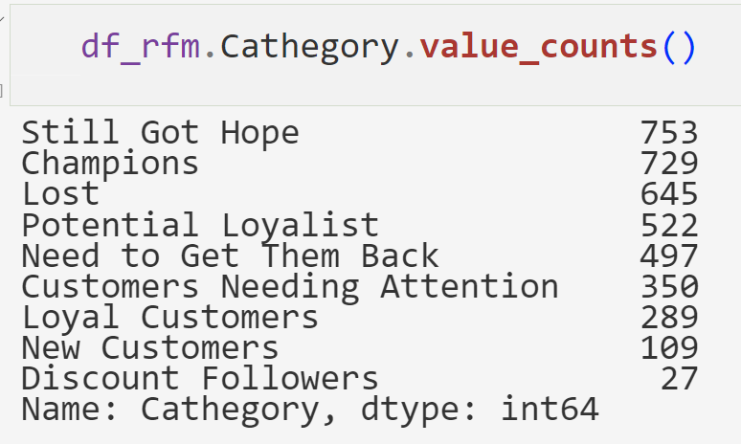
RFM analysis with ohne weighting

Slide 22
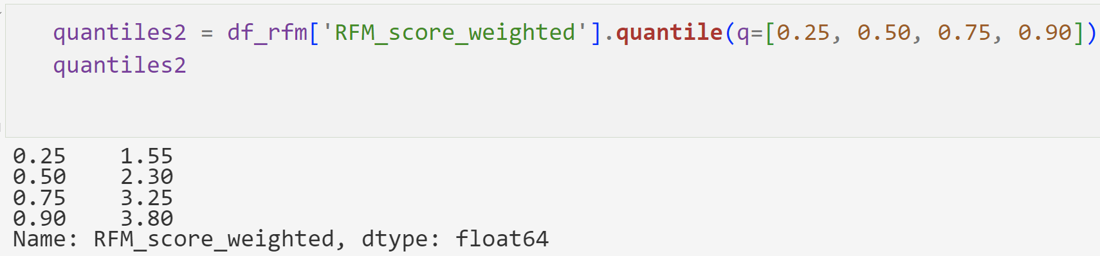
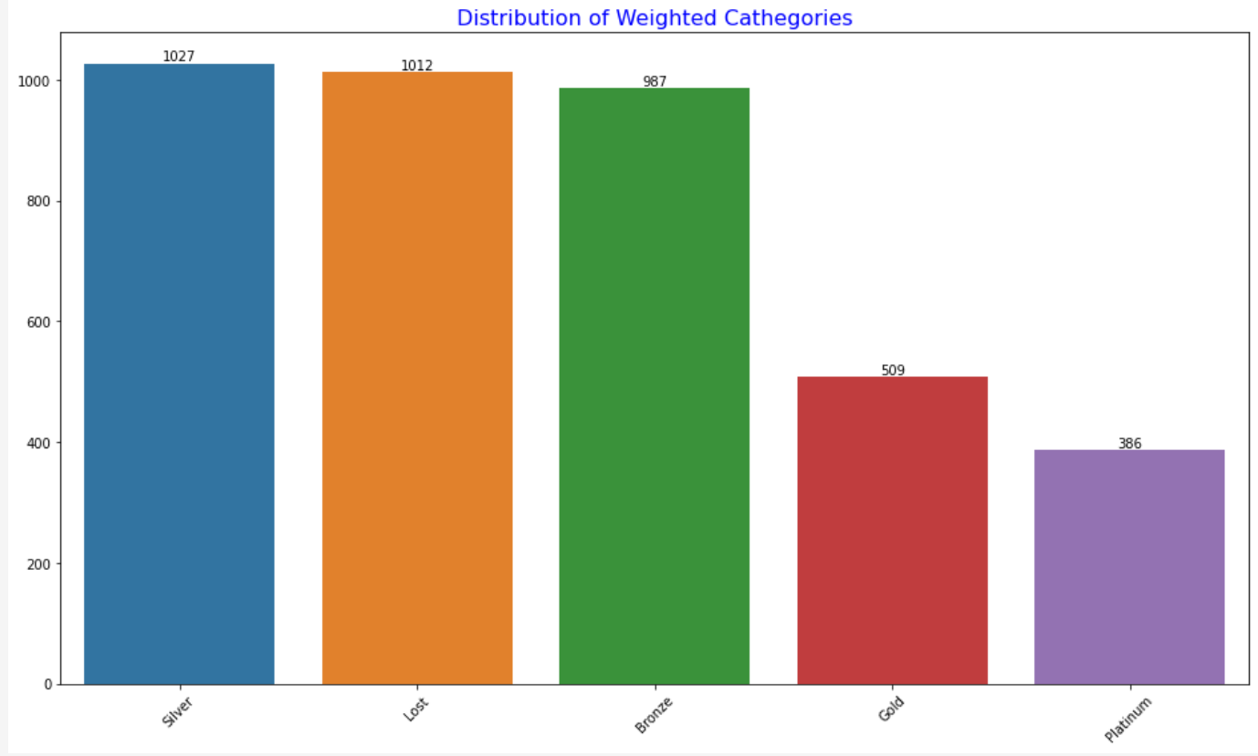
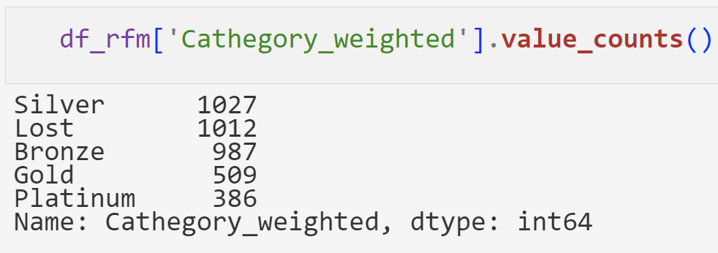
Rfm analysis with weighted features
How many customers do we have in each segment?

Slide 23
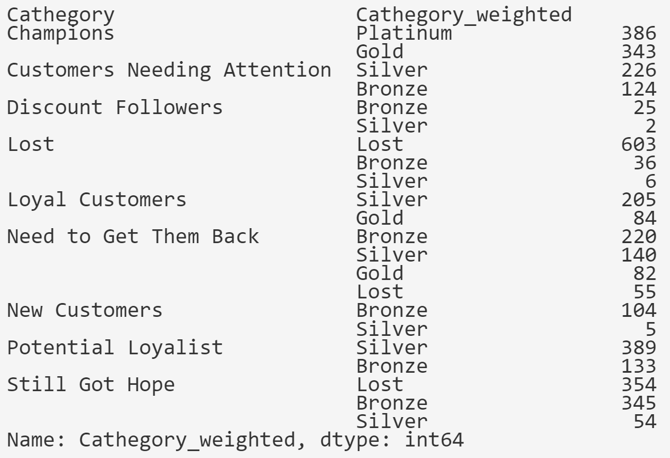
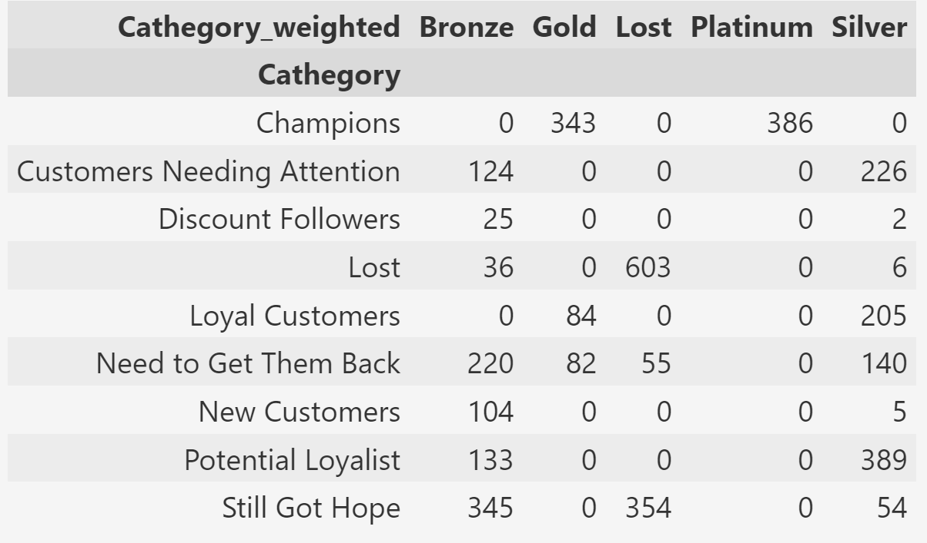
COMPARISON OF WEIGHTED RESULTS WITH UNWEIGHTED

Slide 24
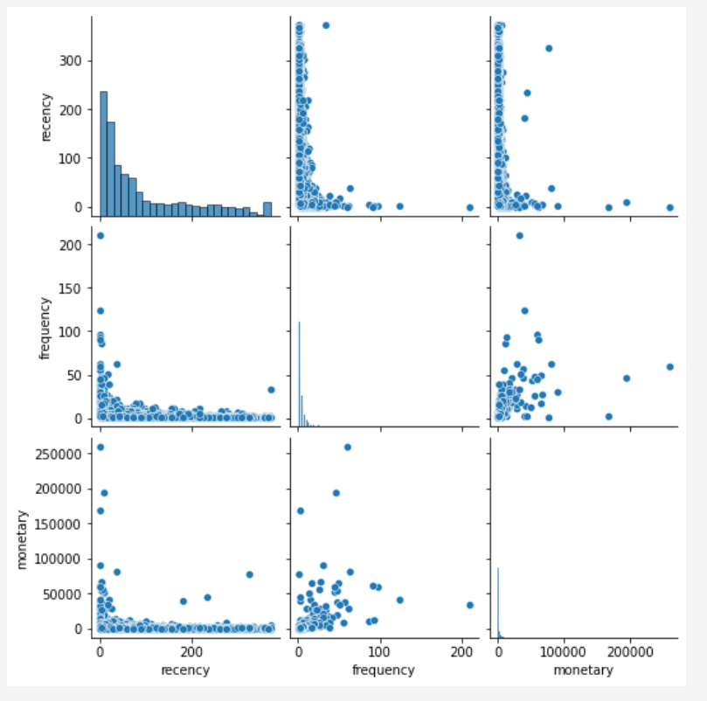

K-means
Before applying logarithm
After applying logarithm

Slide 25



Determining the number of clusters

Slide 26




Model fitting

Slide 27


Visualizing the Clusters

Slide 28



Comparing the clusters with weighted rfm results

Slide 29



Comparing the all results

Slide 30

Comparing the all results

Slide 31


Cohort analysis

Slide 32


Cohort analysis
The last transaction date is December 9, 2011. The number of customers in the last cohort is very low compared to the others, as there are no transactions in the remaining 2/3 of this month.

Slide 33


Cohort analysis
In the first cohort in November the company did something and the number of customers visiting the site again for shopping increased(%50).

Slide 34
conclusion
During the project, we performed three different types of analyses independently. All three analysis methods offer some specific advantages and also have limitations. In this project, we were able to see in which area and to what extent we should use these methods.
First, we used RFM segmentation to divide our customers into insightful clusters. What makes RFM analysis attractive is the flexibility it offers. We can specify the segmentation in terms of our business needs.
Then we applied K-Means clustering to see the unsupervised machine learning results as clusters. When we compared the resulting clusters with segmentations obtained in the RFM analysis, we can say that the segmentation of the weighted RFM analysis and the Kmeans segmentation are similar. In other words, Kmeans algorithms can also be used for customer segmentation processes.
Finally, we used cohort analysis to gain new insights from the data related to time-based cohorts. The strength of cohort analysis is its elasticity, as it provides specific analysis based on business needs.

